Slide 1
Basics of NLP in Health
Alexander Baker

Slide 2

Why Text?
Approximately 70-80% of all data is unstructured
Medical data in particular is heavily reliant on unstructured fields
Doctor’s Recordings
A Variety of Device, Food, and Drug Forms
Doctor’s Notes
Nurse’s Progress of Care Notes
Inspection Descriptions
Device Problem and Recall Descriptions
These text fields can be used to produce powerful models

Slide 3
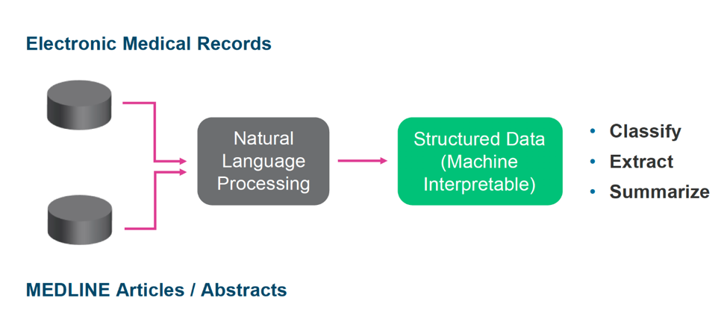
What is Natural Language Processing
Computers do not have the inherent ability to interpret text
Natural Language Processing is a general term referring to the translation of text into numerical data for the computer to property interpret.
There are two general phases of NLP that will be reviewed:
Text Cleaning - The process of deleting all unnecessary, incorrect, or redundant information
Vectorization - The process of turning the cleaned text into a numerical form for algorithms to process

Slide 4
Punctuation
The first step when preprocessing text is to delete punctuation
This will both reduce redundant information, and will allow for stop words to be more easily detected
Typically non-alphanumeric or non-alpha characters are deleted during this process
String.punctuation and nltk can provide a list of these characters
Use EDA and domain knowledge to determine if any non-alphanumeric characters should be spared
James, my neighbor, is a doctor.
James my neighbor is a doctor

Slide 5
Stop Word Deletion
Stop words are commonly used words contributing little meaning to the whole sentence (e.g. I,a,you,and,is).
Deleting these will reduce preprocessing time, data storage, allow for more effective text analysis, and provide a better input for the model
This will also make spell checking faster
One must be wary when selecting stop words
There is a generalized list of stop words using nltk
Domain knowledge and EDA can provide additional stop words and allow for the reconsideration of stop words
There are numerous medical stop word databases
James my neighbor is a doctor
James neighbor doctor

Slide 6
Respelling or Autocorrect
Misspellings are quite common within medical data
A misspelled word represents two words with the same meaning
Misspelled words can waste data storage space, increase computation time, and provides poor input variables for your models
Misspelled words also reduce the effectiveness of lemmatization algorithms
There are general spell correcting methods(e.g. Symspell,hunspell)
A contextual spelling algorithm, or a spelling algorithm tuned or trained with medical data may provide better results
Respelling is performed after stop word deletion to decrease computational time
Ct sat mat
Cat sat mat

Slide 7
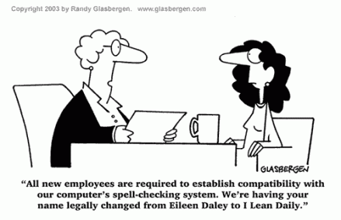
Autocorrect Caution
Important to check the results of the selected spelling algorithm
Domain knowledge can help
Potential to change properly spelled words into different ones
May change the entire meaning of a text entry
Acronyms must be preserved within Medicine

Slide 8
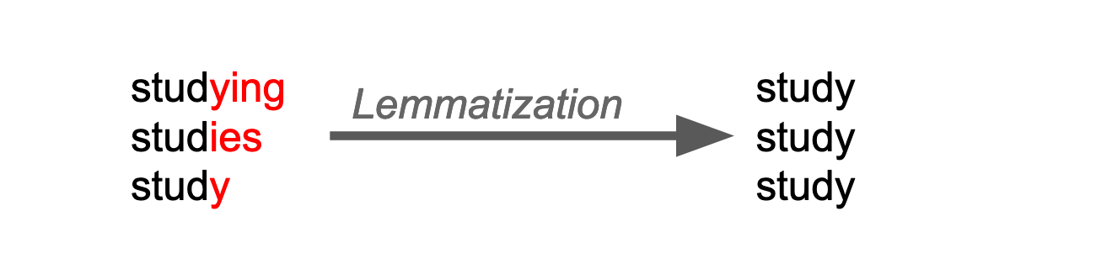
Lemmatization
Similar to respelling, both lemmatization is meant to reduce the frequency of two words with the same meaning
As with spelling non lemmatized text can have the same effects on the dataset
Lemmatization is the process of grouping together inflected forms of a word
For example better will be changed to good upon lemmatization
There are generalized lemmatization algorithms (e.g. WordnetLemmatizer, treetagger)
Algorithms tuned with medical data will provide a better result.
Cat sat mat
Cat sit mat

Slide 9
Vectorization
Vectorization is the method in which you turn your text into numerical inputs for your machine learning models
The CountVectorizer just find the occurrences of a word per document, allowing for easy storage and exploration
The Tf-idf (Term Frequency - Inverse Document Frequency) is similar to the CountVectorizer, but use the inverse document frequency as a normalizing component.
Both are decent algorithms that allow for simple data exploration
There are numerous vectorizers that are more black box, but provide a better vector representation of the text:
Doc2Vec
LSTM
BERT
XLNet
CNN
Unlike the Count and Tfidf , these algorithms provide vectors taking word relations, context, and word dependencies.
Pretrained vectorizers on medical data exist, these can vectorize and represent the nuances in medical text without the additional step of model training.

Slide 10
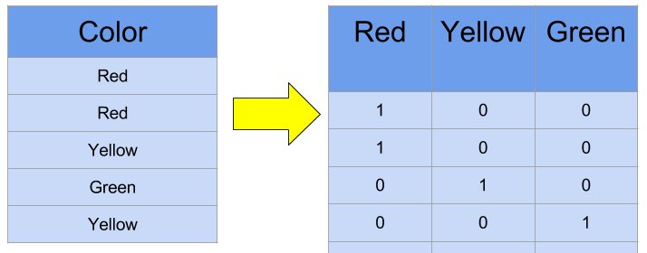
Basic Vectorization Example

Slide 11
Models
The proper machine learning model selected depends on the goals and data associated with the project
It is worth testing and optimizing a wide variety of modeling techniques
Some ML algorithms can efficiently handle datasets with a high number of columns (apt particularly for data processed with tf-idf or cv)
These models include:
Naive Bayes
Logistic Regression
Linear SVM
These models will provide proper transparency and quick results
As with the vectorizers, there are more black box methods that can potentially create more powerful models (e.g. neural networks, random forest, xgboost, lightgbm, etc.)

Slide 12
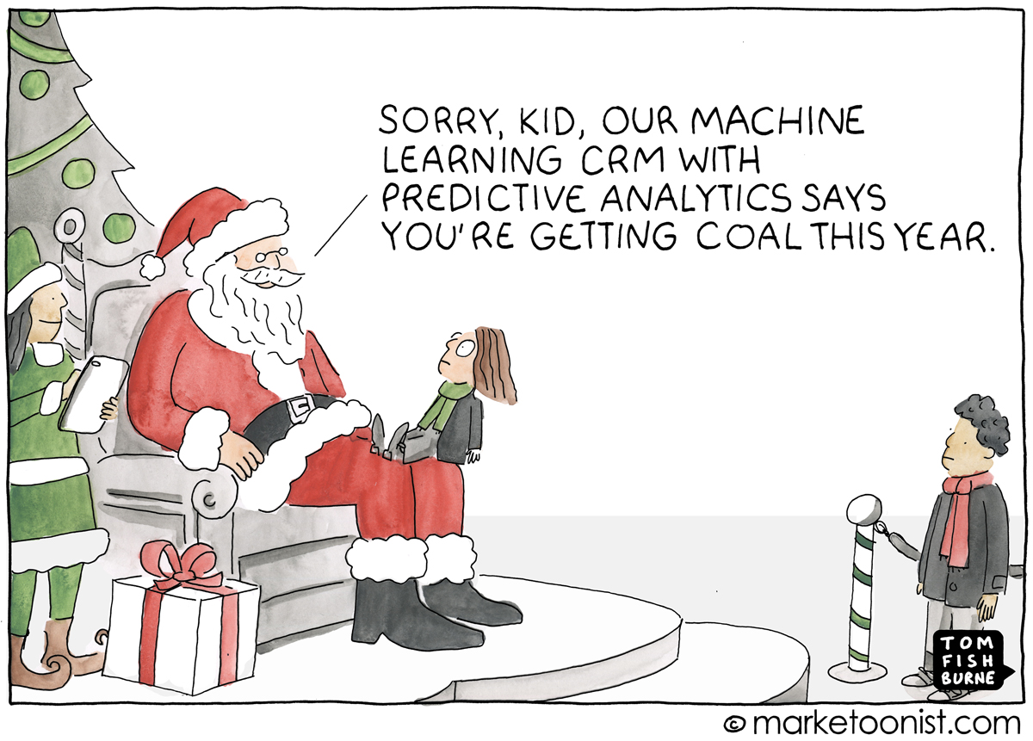
Warnings With Black Box Algorithms
Numerous downsides to low transparency
Uncertainty about how the model is making its decisions
Unknown bias present
Can be difficult to establish trust
Can unknowingly lead to catastrophic results in implementation

Slide 13
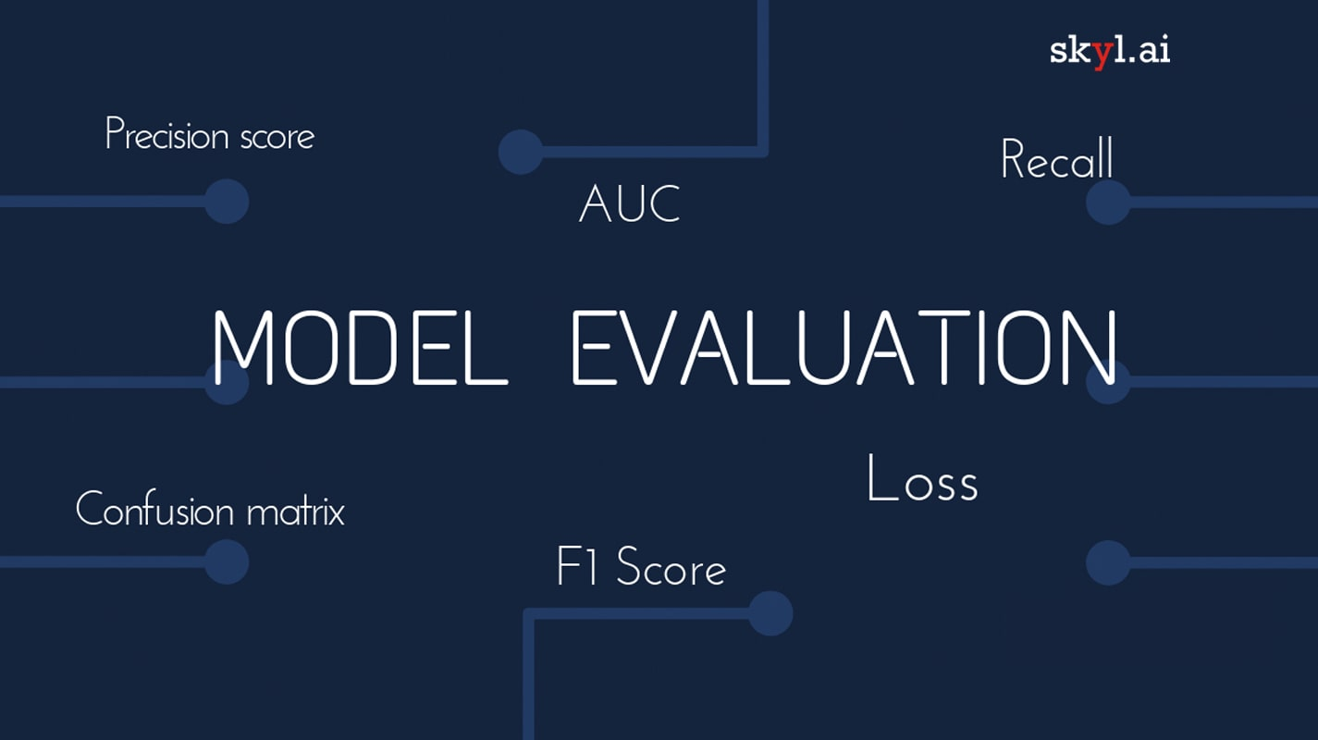
Evaluation
Use a hold out testing set
Use k-fold cross validation to tune and select your algorithms
Select the model with the highest accuracy, and analyze any metrics seen fit
Evaluate the accuracy of your model on the hold out set
Observe for instances of bias within your model

Slide 14

Display Results
A wide variety of dashboard applications can be used to display your solution (e.g. Javascript, Dash, Tableau, Shiny, etc.)
Streamlit is a new and easy dash tool to perform this
The syntax is quite similar to python, and it integrates most popular data science libraries easily
The models will be pickled and opened within the Streamlit script
the data preprocessing pipeline will be implemented brought to this script as well.
Ideally, this data will also be stored in a back end and used for model retraining through an automation script

Slide 15
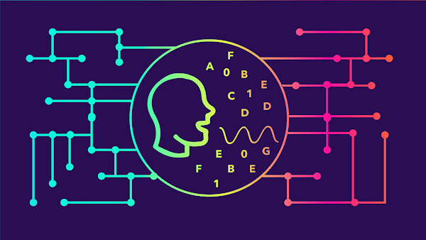
Takeaways
Adjust each of these techniques to your respective domains
Be creative and curious when approaching NLP
Domain knowledge and EDA are the basis are the most valuable tools at your disposal
Only use vectorizers and models that will best suit your needs
Create visualizations to satisfy your goals

Slide 16
If You Have Any Questions
Email: alex_b443@yahoo.com
Phone Number: 571-263-3464 (text or call)
Linkedin: Connect With Me

